Slide 1
Dynamic Adaptive Streaming for Multi-Viewpoint Omnidirectional Videos
Junpeng Qiu
jqiu6

Slide 2
Outline
Objectives & Motivation
Background Knowledge
Algorithm
Evaluation
Pros & cons
Suggestions
Conclusion
Q&A
References

Slide 3
Objective & Motivation
Objective: Streaming videos in Virtual Reality:
Conditions: multi-viewpoint choices & free head rotation
Study: quality of expiriece (QoE) & bandwidth under proactive/reactive stratiges
Streaming of omnidirectional video: bandwidth >> regular video
Current VR Streaming:
Only responding to head orientation
Not displacement involved
Degree of Freedom (dof): 3
Introducing displacement -> dof of 6, more immersive

Slide 4
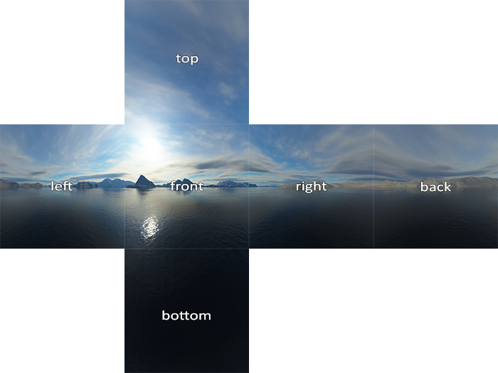
Background Knowledge
Tiling:
Segment each omnidirectional frame into pieces, i.e. tiles
Individually playable -> download tile(s) in view, not whole frame
Example: cubemap baseball layout

Slide 5
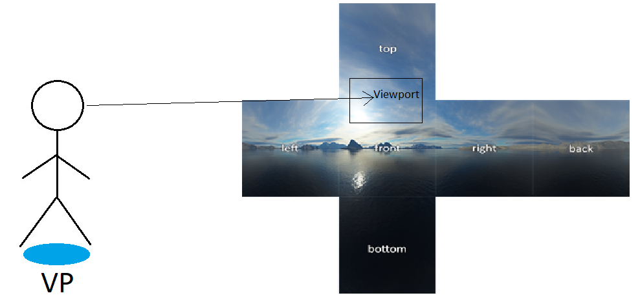
Background Knowledge
Viewport v.s. viewpoints (VP)
Viewport: viewed portion on the frame/tile(s)
VP: audience position within the VR world

Slide 6
Background Knowledge
QoE metrics:
Distortion:
Displayed v.s. original content for given viewport
Comparison Algorithms:
Peak Signal to Noise Ratio (PSNR): avg err of pixel intensity
Multiscale-Structural Similarity (MS-SSIM): structural similarity, range from 0 to 1
Stalls:
pause due to current frame/tile(s) unavailable, likely after unanticipated viewpoint switch
Viewpoint Switching Lag:
Times cost to execute viewpoint switch command: can only switch when viewports available to display in such VP

Slide 7
Background Knowledge
Bit-rate & quality
Higher quality requires higher bit-rate
Server stores frames/tile(s) in multiple quality
Switch VP or tile(s):
Immediately provide lower quality streaming to catch up
Stable: switching to higher quality

Slide 8
Background Knowledge
Predict
Network condition in next sec
VP switch
Head orientation
For deciding downloading representations at certain
Quality
Time segment
VP
Frame/tile(s)

Slide 9
Background Knowledge
Only 2 extreme cases studied:
Proactive strategies:
Download representation of current quality and frame/tile(s) at all VP for future segment
Reactive strategies:
Only download future segment for current VP until commanding VP switch

Slide 10

Algorithm
Notations:
$q$: quality
$v$: VP
$τ$: tile
$r_{i,q,v,τ}$: representation at segment i, quality q, VP v, and tile $τ$
$b_{i,q,v,τ}$: bit-rate for downloading $r_{i,q,v,τ}$
$d_{i,j,q,v,τ}$: downloaded ration of $r_{i,q,v,τ}$ at time segment j
$s_{j}$: number of segments waited for downloading segment j
$S_{j}$: whether stall occurred at segment j

Slide 11

Algorithm
Binary variables:
$x_{i,q,v,τ}$: if user wants $r_{i,q,v,τ}$
$y_{i,v}$: if user wants to switch to VP at v in time segment I
Average distortion:
$Q_{i,q,v,τ}$: actual v.s. displayed $r_{i,q,v,τ}$
Multiple tiles can be within a viewport:
Weighted avg of distortion, weight: portion of tile(s) within the viewport $V_{i},τ$
$Q_{i}={\sum_{v,τ}{V}}_{i}∙(\sum_{q}{(x_{i,q,v,τ}∙Q_{i,q,v,τ})})$

Slide 12
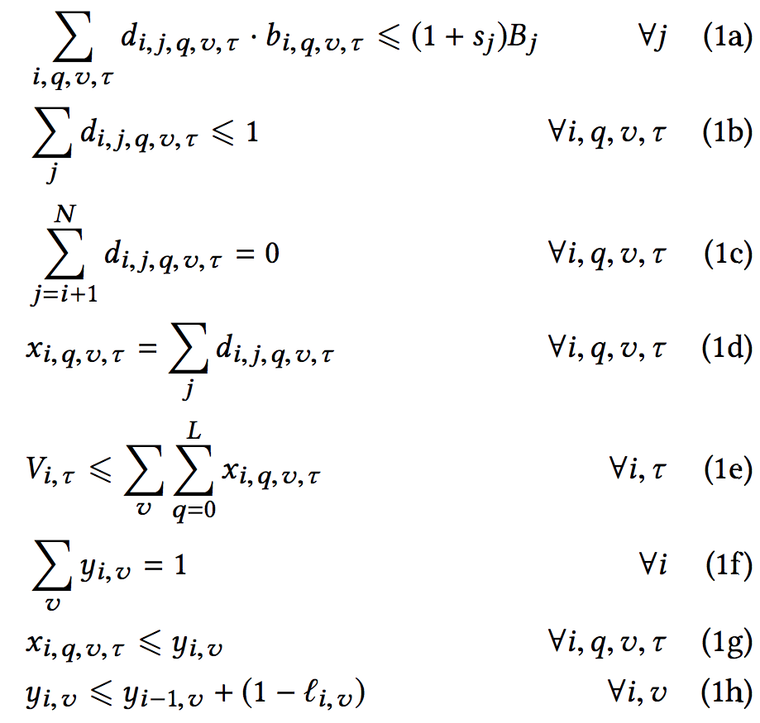

Algorithm
Quantify QoE:
$min\left\{x_{i,q,v,τ}\right\}\sum_{i}{\left(Q_{i}+β∙l_{i,v}∙y_{i,v}\right)}+α\sum_{j}{(s_{j}+S_{j})}$
$α$ and $β$ are constants that will be evaluated later
Conditions:

Slide 13
Algorithm
Bandwidth constraints
Same representation at most download once (redundant)
No downloading past deadline
Only fully downloaded representation can be displayed, summation of d is confined to 0 or 100%
Force to display one available r when tile visible in i
1 and only 1 VP is selected in any i
Certain representation can only be displayed if in VP v
Representation can be from previous segment

Slide 14

Algorithm
Constraints modification for both strategies:
Proactive: download other future frame/tile(s) at every VP
$$\sum_{v^{,}}{x_{i,q,v^{,},τ}}=\sum_{j}{d_{i,j,q,v,τ}}$$
Reactive: not download future frame/tile(s) at other VP
$$\sum_{j}{d_{i,j,q,v,τ}}≤y_{\max\left(j,0\right),v}+y_{\max\left(j+1,0\right),v}$$
after switch command to VP v at j+1, forcing downloading order:
$$\sum_{i,q,τ}{d_{i,j,q,v,τ}∙b_{i,q,v,τ}}≤\left(1−t_{j}+s_{j}\right)B_{j}$$
(There are errors for updated constraints of reactive approaches in paper, I fixed it as shown above)

Slide 15
Evaluation
Simulation conditions:
Four minute long omnidirectional video
Three VPs’
Segment: 60 per sec
Tilings:
No tiles
3X2
6X4
Avg bit-rate:
5 Mbps (low resolution)
8 Mbps (medium resolution)
16 Mbps (high resolution)

Slide 16
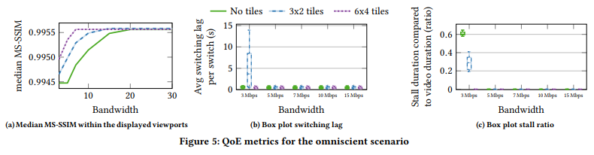
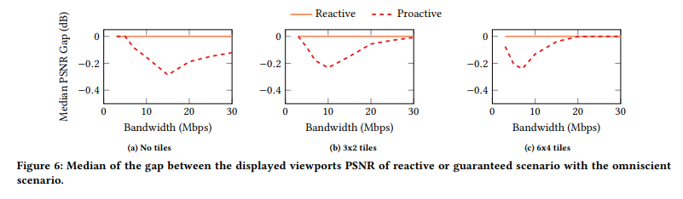
Evaluation

Slide 17
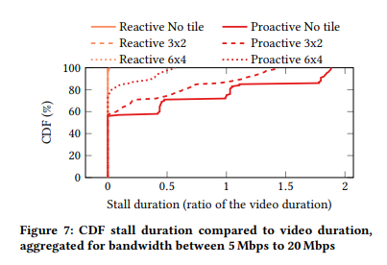
Evaluation

Slide 18
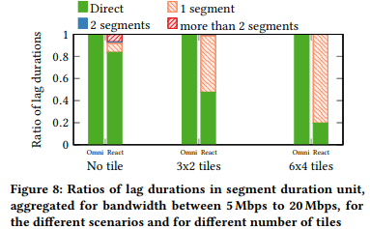
Evaluation
Proactive allows immediate switch
Switch command:
Sent at earlier or later section of a segment
If sent at very end of a segment: highly possible for delayed switch

Slide 19
Pros & Cons
Pros:
Attempt to explore into VR streaming with VP switch available
Good effort spent on coming up with formal math model for quantifying dissatisfaction metrics
Cons:
Introduced a lot of unrelated terms:
Moving strategies
Summation of dissatisfaction terms
Redundancy and errors within the math models
No explanation on how results bound the performance in a practical (more realistic) model
No study on server sides

Slide 20
Sugestions
Run simulation with more VPs’ (more cameras)
Make it clear how the results bound bandwidth, QoE metrics, etc, for a more practical model
Studying relations between predication accuracy and bandwidth rather than just 2 extreme strategies
Study server load

Slide 21
Conclusion
Few related work in VR streaming w/ VP switching available
Download strategies for four discrete dimensions: time segments, tile(s), VP, quality
Main observations from paper:
Tiling decreases bandwidth, highly beneficial to streaming
Proactive/reactive: excessive prices
No clear relations drawn for the results and a more practical model
No study on server sides

Slide 22
References
L. D’Acunto, J. van den Berg, E. Thomas, and O. Niamut. Using MPEG DASH SRD for zoomable and navigable video. In Proc. of ACM Multimedia Sys. (MMSys), 2016.
L. Toni and P. Frossard. Optimal representations for adaptive streaming in interactive multiview video systems. IEEE Trans. on Multimedia, 19(12):2775ś 2787, Dec 2017.
W. Zhang, S. Ye, B. Li, H. Zhao, and Q. Zheng. A priority-based adaptive scheme for multi-view live streaming over http. Computer Communications, 85:89 ś 97, 2016. ISSN 0140-3664

